Slide 1
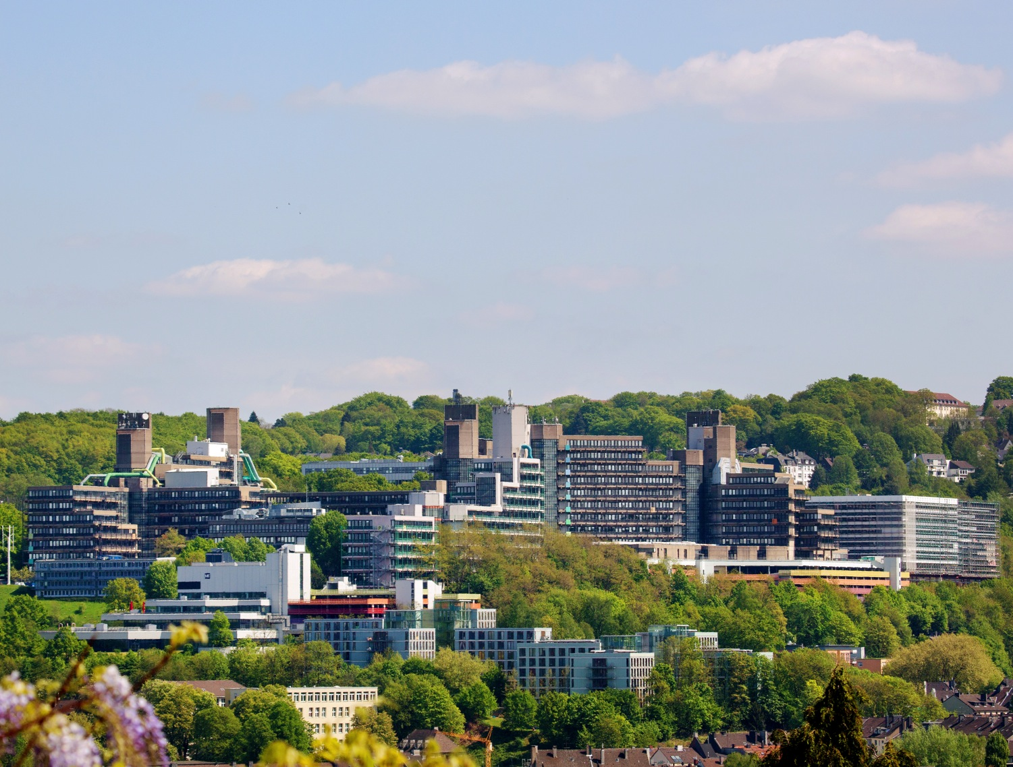

Research Data Management (RDM)
February 24./25. 2026
Photo: Sebastian Jarych

Slide 2
Topics
Basics: What are research data, data life cycle, benefit of RDM
How can I find research data?
Persistent identifiers: DOI, URN, ORCID, ROR
Licences for research data
Requirements of our university and DFG
Data management plan, RDMO
Research data repository PublicData.fdm.uni-wuppertal.de
Technical quality assurance

Slide 3
Basics

Slide 4


What are research data? From DFG Checklist:
Research data includes … texts, …, methodological test procedures …
Compilations, software and simulations can equally represent a central result of scientific research and are therefore also included under the term research data.
Usually not research data:
Papers
Application
Simulations
Input
Output
Software
Research data
Docu
Issues Remarks Errata
Processed data (spreadsheets, visualizations)
Benchmarks

Slide 5
Exercise data lifecycle
Assemble a six-stage lifecycle for research data.

Slide 6
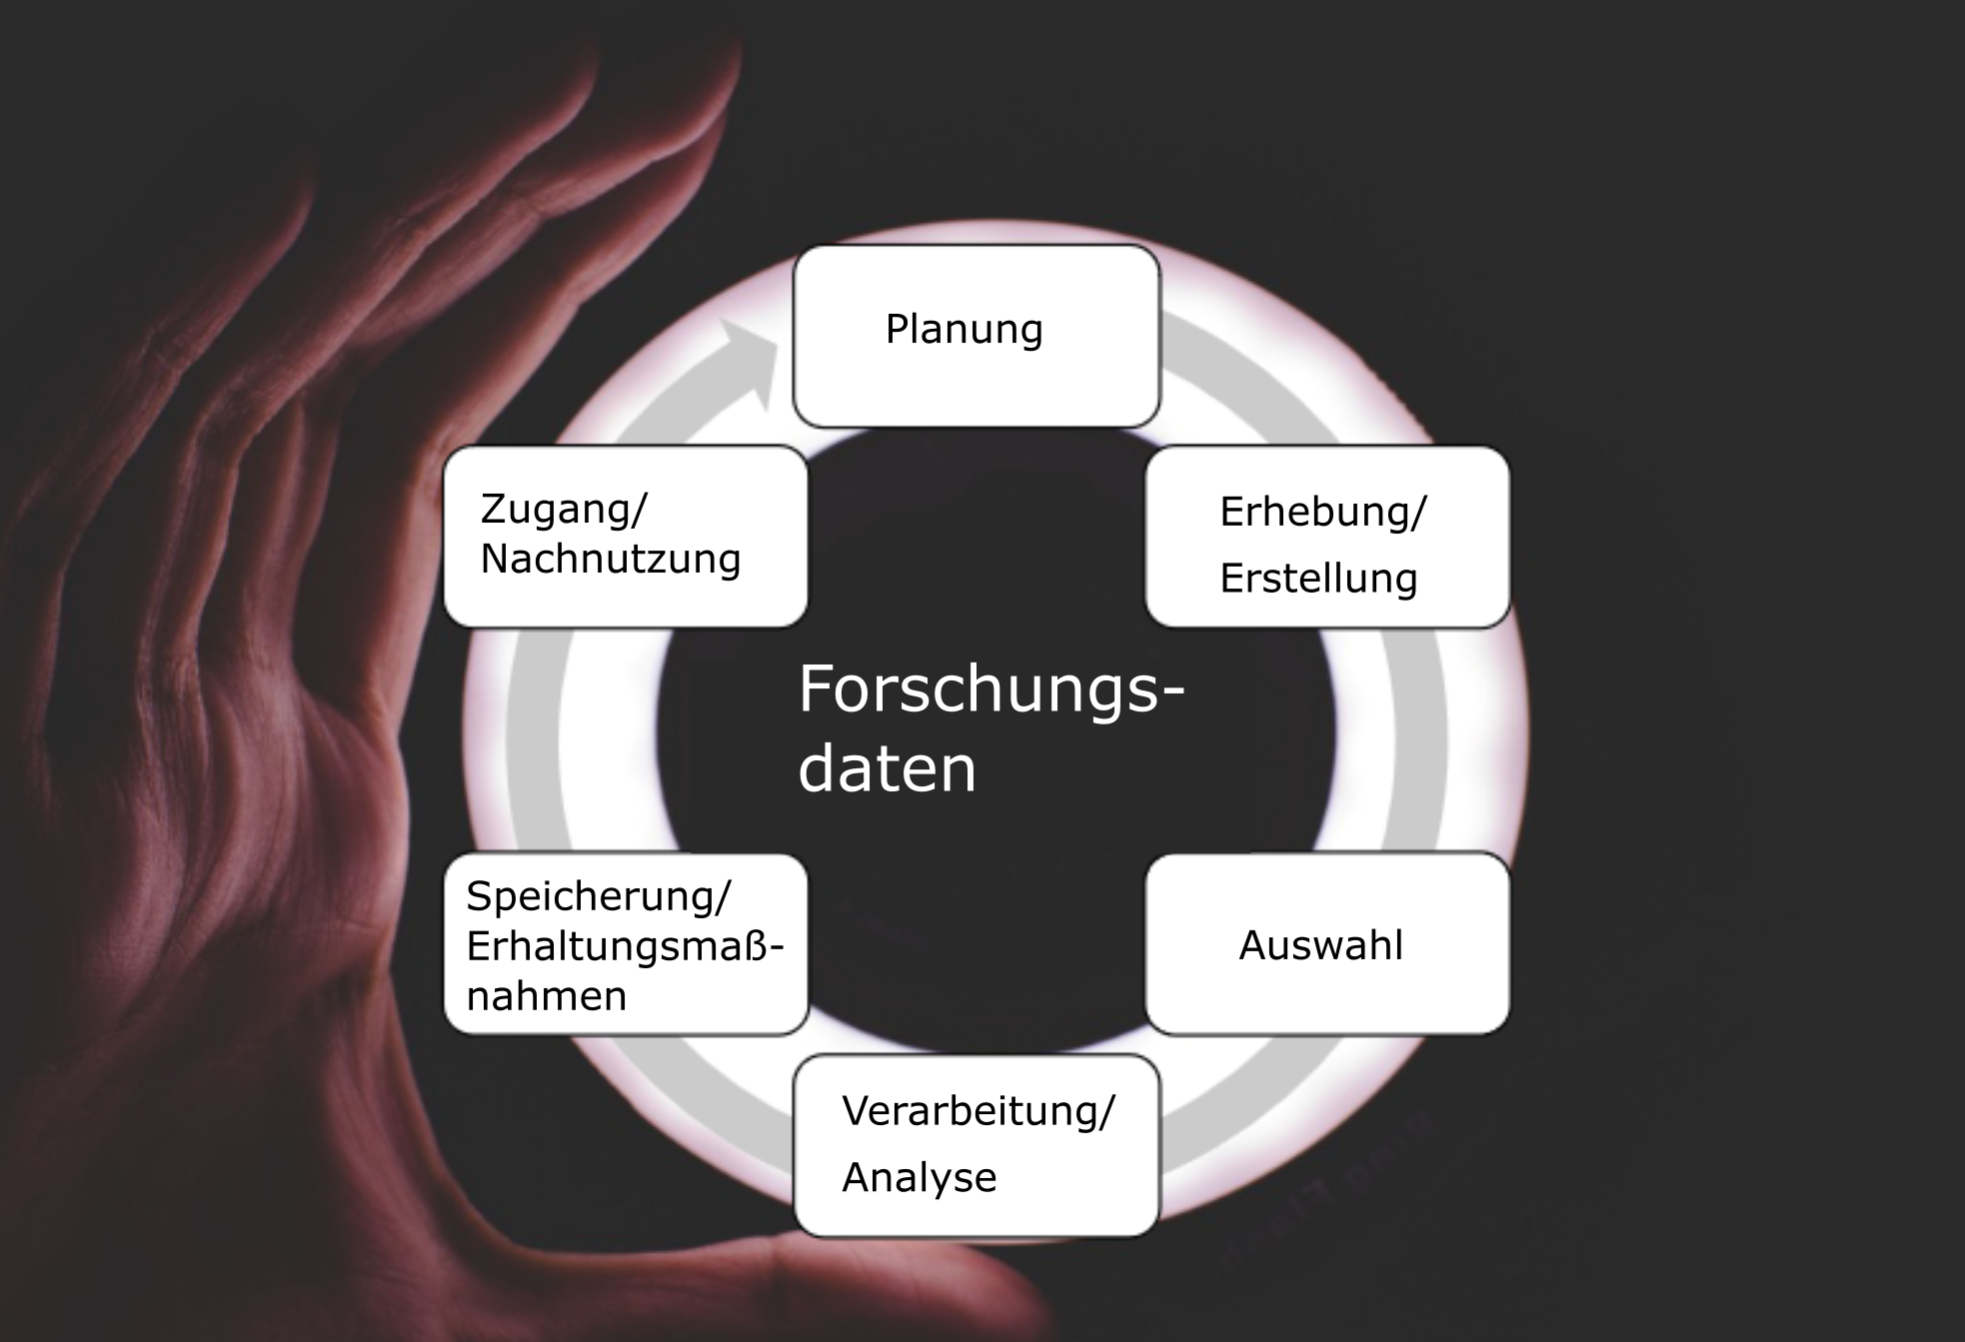
Data lifecycle
Planning
Access/ re-use
Creation
Storing/ curation
Selection
Processing/ analysis

Slide 7

Why research data management?
Avoid duplication
Enable re-use
Good Research Practice
Notes:
Data collection is hard work. So it should not unnecessarily be repeated
Extended research on the same RQ can take place
Data can answer multiple research questions, even from different fields
- Easy & organized access to research data improves science both in speed and quality

Slide 8
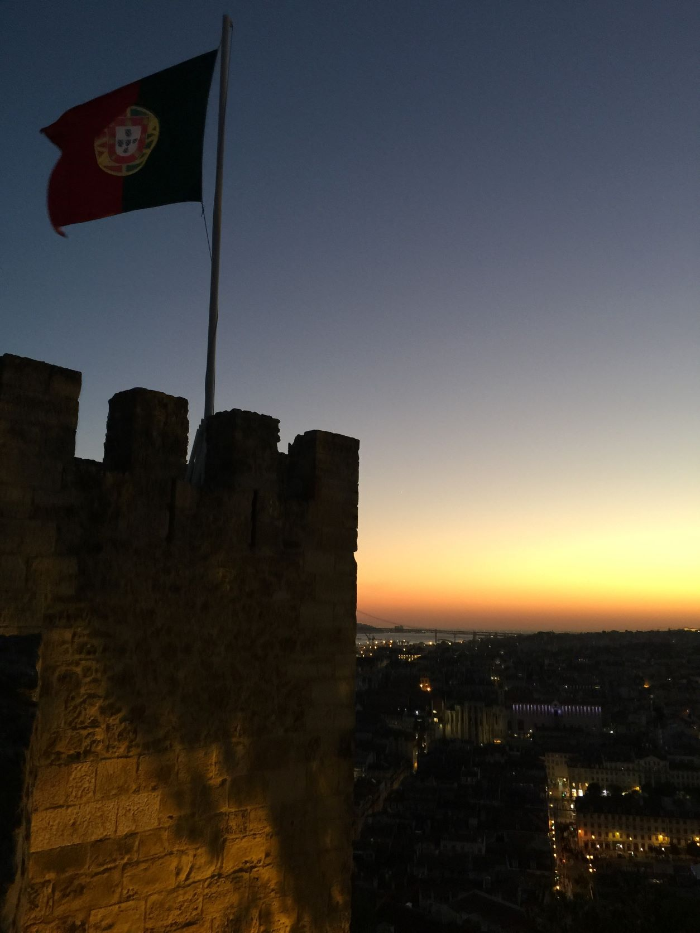
Safety
Security
Curation
Long-term
Notes:
- Researchers are (often) not IT professionals & don't need to be
- The people at the data centers are
- Ensure university staff (& others) can access research data
- Become independent of people, software & hardware

Slide 9

Funding
Help
Visibility
Notes:
Data collection is hard work. So it should not unnecessarily be repeated
Extended research on the same RQ can take place
Data can answer multiple research questions, even from different fields
- Easy & organized access to research data improves science both in speed and quality

Slide 10
Where can I find research data?

Slide 11
Where are publicly accessible research data stored?
Data center
Data about data
Metadata
Metadata
Data set
Data set
Web service or managed directory
Repository
Repository

Slide 12
How can I find research data?
Link in monograph or paper
Two-stage: a) search for repositories, b) search in repository
re3data.org (registry of research data repositories)
risources.dfg.de
Direct search for data sets
Google Dataset Search, https://datasetsearch.research.google.com/
Other search engines
DataCite search, https://search.datacite.org/

Slide 13
Persistent Identifiers

Slide 14
Part I: Persistent identifiers for digital objects: URN, DOI
Part II: Persistent identifier for researchers: ORCID
Part III: Persistent identifier for institutions: ROR

Slide 15
Why are "web addresses" (URLs) not sufficient?
Page not found
A URL (Uniform Resource Locator) describes the location of a resource. Problem: The locations of digital objects can change, domains are frequently abandoned, and URLs are not redirected.
URLs are therefore considered unreliable.
Notes:
Warum benötigen digitale Objekte PIDs?
Anders gefragt: Warum eignen sich URLs für den verlässlichen Zugang zu digitalen Objekten nicht?
https://www.fbd.uni-wuppertal.de/
„Dokumente, deren Internetadressen sich ändern, sind wie verstellte Bücher in der Bibliothek“
URLs gelten als unzuverlässig – es gibt keine technischen Gründe, dass URLs ihre Gültigkeit verlieren

Slide 16
Idea: PID instead of “Web address“
Properties of PIDs
exist globally only one-time, i.e. unique
permanently valid
via software/database („resolver“) resolvable, leads to the current storage location of the object
Advantages
unique and permanent identification of electronically published research results (e.g. journal articles, research data)
ensuring their permanent findability and citability
Notes:
Was sind Digitale Objekte:
Publikationen (Zeitschriftenaufsatz, Datensatz, E-Book)
Gerade bei der Publikation von Forschungsdaten wichtig, wenn diese als eigenständige wissenschaftliche Leistung anerkannt werden soll (Argument sonst: zu viel Arbeit, fehlender Anreiz, keine Belohnung)
Damit: Gewährleistung der Referenzierbarkeit und Zitierfähigkeit

Slide 17
Principle of PID systems
1. PID with resolver address
http://<resolver-address>/PID
PID resolver
2. Location: URL
Current location is entered in a database
3. Require web object from current location
4. Required web object
Current
location
Notes:
Grundidee: strikte Trennung von Identifikation der Publikation und Standort
Ein PI ist unabhängig von der Adresse eines Objektes und bezeichnet nicht dessen Aufenthaltsort
Alle PI-Systeme funktionieren nach einem ähnlichen Prinzip:
- PI können nicht direkt in die Adresszeile des Browers eingetragen werden. Man bildet einen URL aus der Adresse des sog. Resolvers und hängt daran den PI an.
- Der Resolver ist vereinfacht gesagt eine Datenbank, in der der PI eingetragen ist und in der (neben anderen Metadaten) auch der derzeitig gültige Standort gespeichert ist.
Im Resolver verzeichnete Daten müssen permanent gepflegt werden, z.B. bei einem Wechsel der Zugriffsadresse. Der PI selbst ändert sich jedoch nicht.
Vorteil: Zitate und Referenzen, die auf den PI verweisen, werden bei einer Veränderung der URL nicht ungültig.

Slide 18
URN (Uniform Resource Name)
Example for a URN of German National Library
https://nbn-resolving.org/urn:nbn:de:hbz:468-20110509-151022-7
URL of the resolver
(for D und CH)
Name space
Sub-spaces
Object denomination
(unique number)
Check digit
 Important especially for dissertations
 Metadata of the objects not in the PID system
Notes:
Hbz = Hochschulbibliothekszentrum NRW
URN können nicht ohne weiteres aufgelöst werden.
Für Forschungsdaten nur bedingt geeignet.
Enge Kopplung an Langzeitarchivierung
Kein genereller Resolver, sondern Resolvingdienste für einzelne
Namensräume (NIDs, Namespace Identifiers)
Metadaten des Objekts nicht im PI-System

Slide 19
DOI (Digital Object Identifier)
Prefix
Suffix
https://doi.org/10.5281/zenodo.1230525
Resolver address
Organization
Object denomination
Notes:
Der DOI (Digital Object Identifier) ist unabhängig von der Adresse eines Objektes und bezeichnet nicht dessen Aufenthaltsort
System (das zentrale Verzeichnis) wird von der International DOI Foundation (IDF) betrieben, Gründung 1997, erste Anwendung 2000
Zunächst v.a. wissenschaftl. Aufsätze, 2005 erstmalig ein Forschuungsdatensatz registriert (TIB)
Unabhängig von der Adresse des Objektes
Die Pflege der registrierten Objekte muss übernommen werden. Dies beinhaltet hier beispielsweise die Aktualisierung der URL in den Metadaten.
„Obwohl offiziell empfohlen wird, DOIs als volle URL anzugeben, ist genau genommen nur der Teil, der mit 10. beginnt, der DOI.“ aus Wikipedia
https://doi.org/10.1007/s11578-010-0094-6
Manche Literaturverwaltungsprogramme können per Eingabe des DOI die Metadaten eines Artikels importieren.

Slide 20
DOI (Digital Object Identifier)
 Operated by the International DOI Foundation (IDF), founded in 1997
Currently 10 registration agencies, including
CrossRef (Focus on publisher publications: journal articles, E-Books)
DataCite (Focus on research data)
 DOI registration is only possible with the submission of metadata
Registration agencies
Data centres
Members
GESIS
TIB
ZB MED
ZBW
hbz
…
CrossRef
DataCite
…
IDF
Univ. Wuppertal
…
Notes:
Verantwortlichkeiten von Datenzentren!

Slide 21
Differences and similarities
URN | DOI
Provided by the DNB free of charge | The university will cover the costs.
Must not be deleted
A valid URL points …
directly to the object or a front page (landing page) | … to a front page (landing page)
Only conditionally suitable for research data
Each URN/DOI partner commits to the ongoing and continuous maintenance of its URNs/DOIs.

Slide 22
Part I: Persistent identifiers for digital objects: URN, DOI
Part II: Persistent identifier for researchers: ORCID
Part III: Persistent identifier for institutions: ROR

Slide 23
Why are personal names not sufficient?
Several Autors can have the same name.
Names can change (e.g., upon marriage).
Various spellings of an author‘s name:
e.g. Karl Peter Müller
Abbreviations of first names: K. P. Müller, Karl P. Müller
Umlauts are resolved to “u“ or “ue“
e.g. Сергей Королёв (russ.), Сергі́й Корольо́в (ukrain.), lat. spelling dependend on transliteration table
Notes:
Warum benötigen digitale Objekte PIDs?
Anders gefragt: Warum eignen sich URLs für den verlässlichen Zugang zu digitalen Objekten nicht?
Was sind Digitale Objekte:
Publikationen (Zeitschriftenaufsatz, Datensatz, E-Book)
URLs sind dazu gedacht, den Ort, an dem sich eine Ressource befindet,

Slide 24

ORCID (Open Researcher and Contributor Identification)
Torsten Rathmann https://orcid.org/0000-0001-5880-1546
Non-profit organization, founded 2010, launch 2012, 11 Mill. yearly active 2025
De facto standard, already mandatory at some publishers and specialist events
Additional data (career, list of publications) can be entered
Data sovereignty lies with the researcher.

Slide 25

Publikationsrichtlinie der Bergischen Universität Wuppertal
The University of Wuppertal recommends that all authors create an ORCID iD for the unambiguous identification of their authorship.
Amtliche Mitteilungen, Jg. 48, Nr. 10 vom 13.03.2019

Slide 26
Part I: Persistent identifiers for digital objects: URN, DOI
Part II: Persistent identifier for researchers: ORCID
Part III: Persistent identifier for institutions: ROR

Slide 27
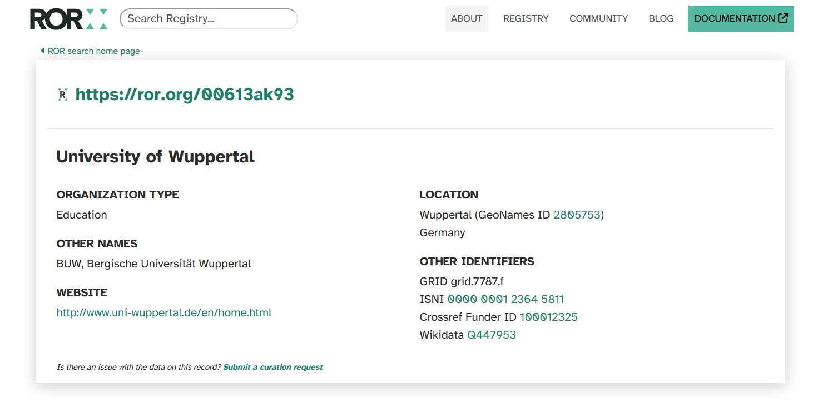
Open, persistent identifier for organisations: Research Organization Registry (ROR)

Slide 28
Licenses for research data

Slide 29
Why licenses for research data that reach the level of originality ("Schöpfungshöhe")?
🛡 Misuse
Clear Rules
Choose from list
🛡
Limitation of liability
Notes:
Several good reasons exist why data owners should deal with licenses for their research data.
- Data owners can protect themselves against claims for indemnification.
- They can inhibit unwanted manners of data use.
- Data owners who use well-known licenses help data re-users since common well-known terms of use facilitate re-use. Without explicit license conditions national intellectual property rights have to be followed and these rights depend on the country.
- Many archives do not permit all possible license texts but let data owners choose one from a list of supported licenses.

Slide 30
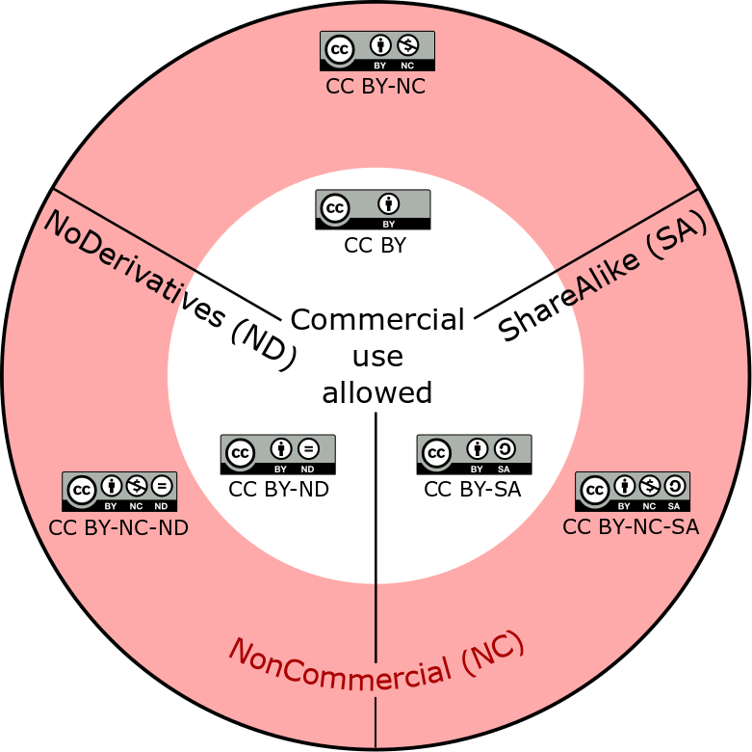
Creative Commons (CC)
Widely used
Free of charge
For all kinds of objects except software
Freely useable (under CC0)
Several different licenses
CC0 most extensive waiver of rights
CC BY: re-user of the work must provide
the name of the creator and attribution parties,
a copyright notice,
a license notice,
a disclaimer notice and
a link to the licensed original.
Notes:
Figure: CC BY itself is the basis; the other licenses contain additional terms to forbid commercial use and how to handle derivative work, e.g. translations or alterations. CC BY-ND does not permit sharing of derivatives whereas CC BY-SA does but only under the same or a compatible license (ShareAlike). Which licenses are compatible is decided by Creative Commons. CC-BY itself allows sharing of derivatives under a different license too. In the pink outer ring are the three licenses which do not permit commercial use.

Slide 31
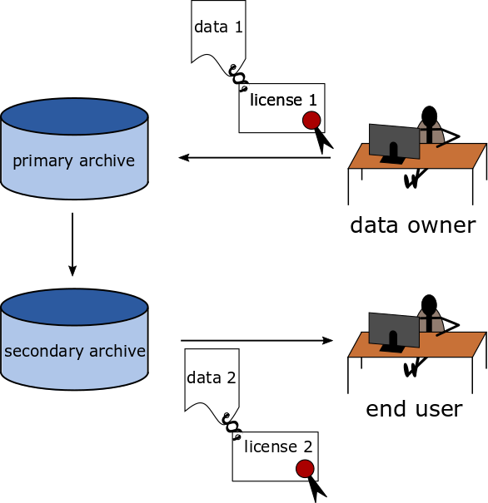
What do SA and ND mean?
ShareAlike (SA)
Re-publication: license 1 = license 2
NoDerivatives (ND)
data 1 ≈ data 2
Serious restriction!
Derivates are important in science.
Does a correction already reach the level of originality?

Slide 32
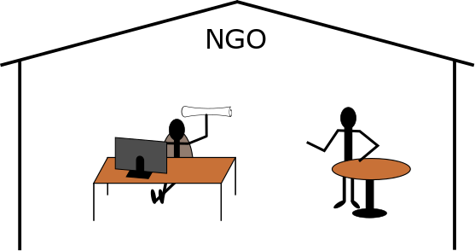
What do NonCommercial (NC) mean?
"NonCommercial means not primarily intended for or directed towards commercial advantage or monetary compensation.”
Issue: Non Government Organizations may be excluded too.

Slide 33
Licenses for software (examples)
GNU General Public License (GPL) | Source code open, Copyleft
GNU Lesser General Public License (LGPL) | as GPL, but no Copyleft, if re-use is only library call
Apache license | Source code need not to be open. Apache license must be included, but custom software does not need to be under the Apache license.
©
Overview of numerous further software licenses:
https://www.gnu.org/licenses/license-list#SoftwareLicenses

Slide 34
Open Data Commons (ODC) licenses for databases
Created to cover database rights (according to § 87b of the German Copyright Act, separate rights of reproduction and distribution for databases), because CC licenses only protect databases from version 4.0 onwards.
Public Domain Dedication and License (PDDL) | Most extensive waiver of rights similar to CC0
Open Data Commons Attribution License (ODC-By) | Similar to CC BY
Open Database License (ODC-ODbL) | Similar to CC BY-SA Most important user: OpenStreetMap

Slide 35
What are the minimum requirements for a research data license?
Granting of a non-exclusive right of use
Disclaimer of warranty
Limitation of liability
Citation obligation
Rules for databases

Slide 36
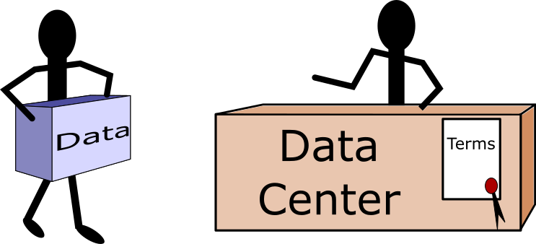
Attention!
Your license must be compatibel with the terms of use of your repository.

Slide 37
Offers and requirements of our University

Slide 38
„Grundsätze im Umgang mit Forschungsdaten an der Bergischen Universität Wuppertal“
(Amtliche Mitteilungen Nr. 93 vom 27.08.2015)
“Project leaders and independent researchers are generally responsible for the research data management of their research projects. In particular, they are obligated to ensure compliance with good scientific practice and disciplinary standards.”
Storage and archiving in the IT infrastructure of the University of Wuppertal (BUW) or in subject-specific repositories (taking into account data protection requirements)
Retention period: at least ten years

Slide 39
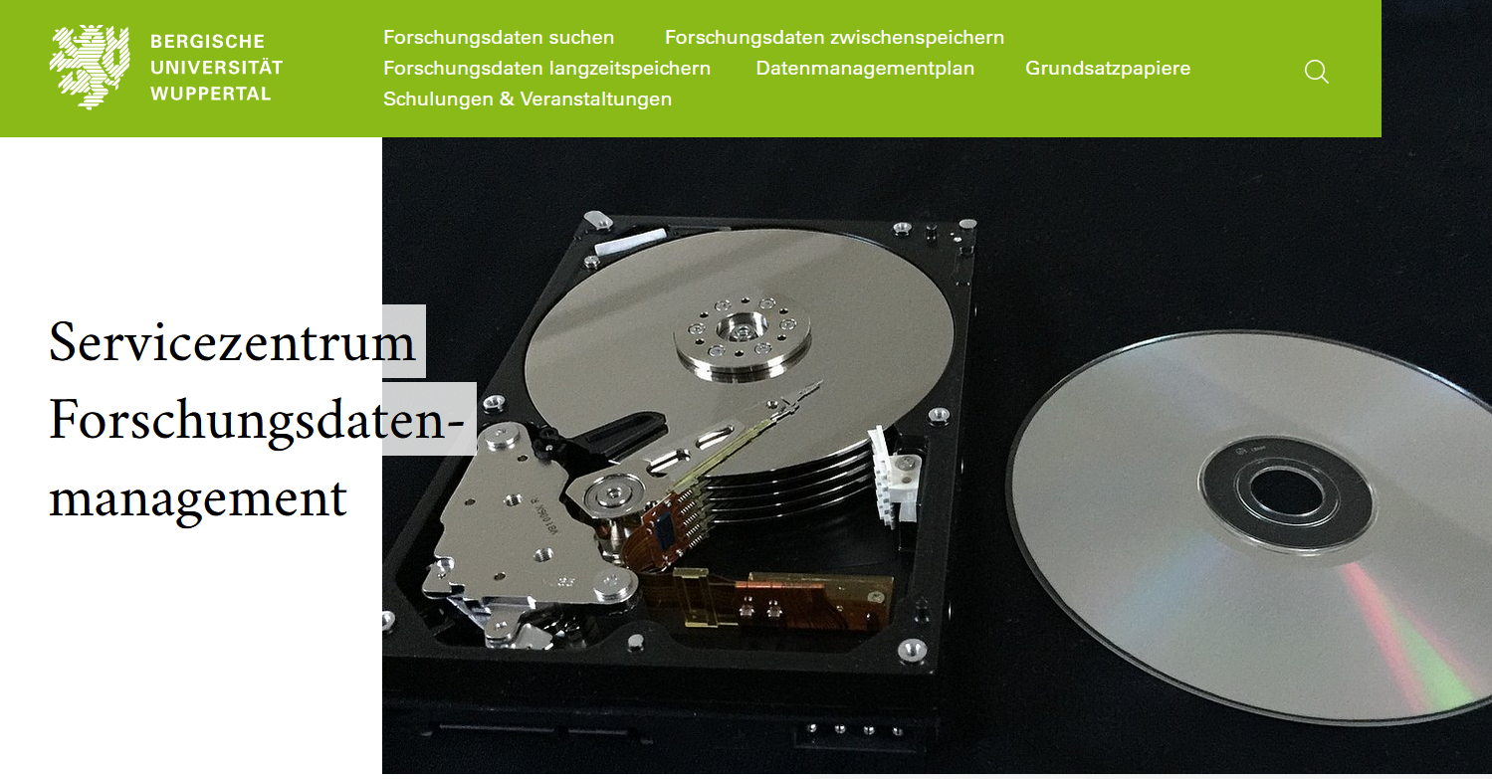
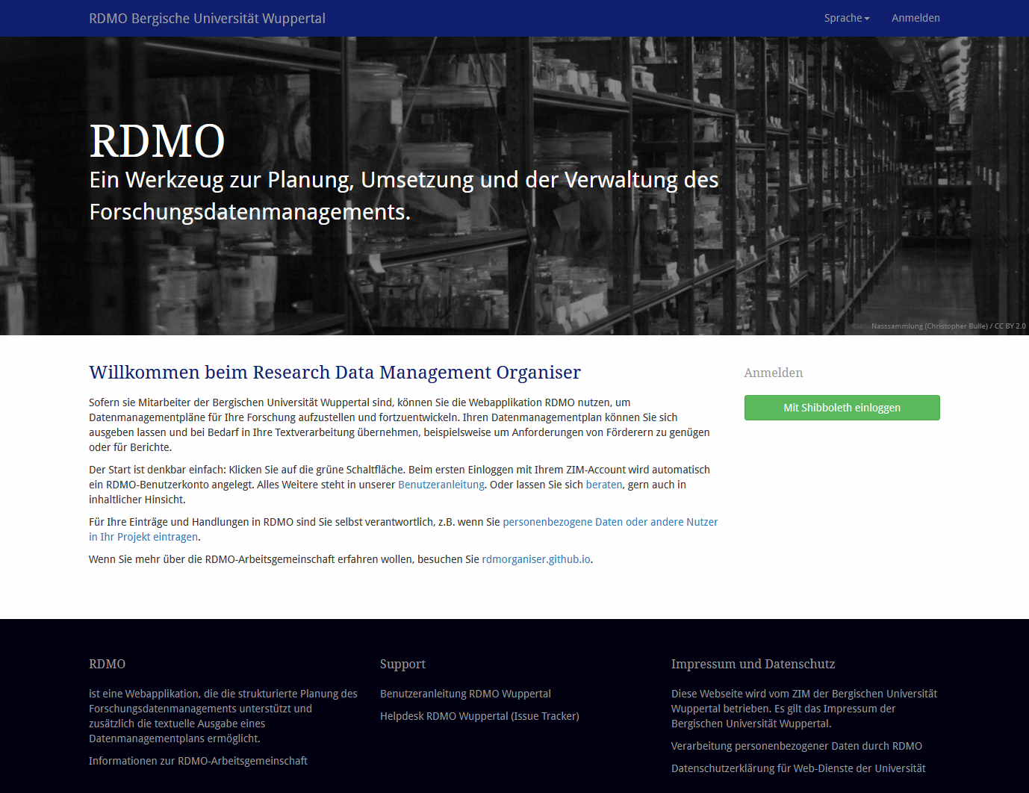
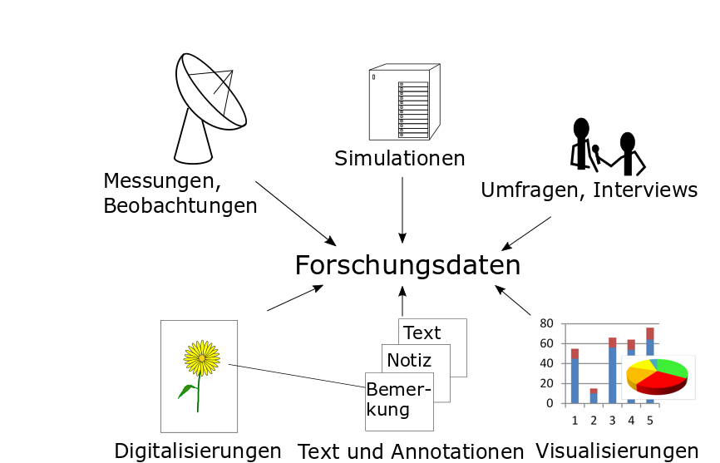
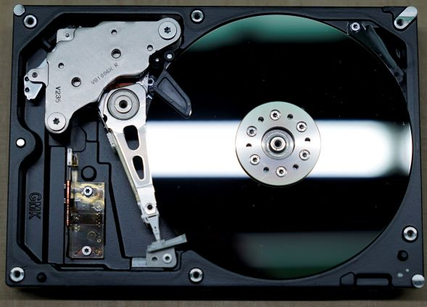
Offers of the Service Centre Research Data Management
Website
Consulting
+
Training
fdm.uni-wuppertal.de
Moodle course
Repository
RDMO

Slide 40
DFG
Requirements of DFG concerning research data management

Slide 41

DFG: Code of Conduct (2019)
Guideline
7 | Quality assurance
12 | Documentation
13 | FAIR
17 | Store primary data ≥10 years

Slide 42
FAIR Data Principles (force11.org)
Accessible
tombstone
license
rich metadata
FAIR
provenance
Findable
Re-usable
persistent identifier
community standards
formal, accessible, shared and
broadly applicable language
for knowledge representation
Interoperable
vocabularies
qualified references to other data
Data human- and machine-readable!

Slide 43
DFG Guidelines on the Handling of Research Data (2015)
Research data should be made accessible
as soon as possible
the publication of research data does not conflict with the rights of third parties (in particular data protection or copyright)
at a stage of processing that allows it to be usefully reused by third parties (raw data or structured data)

Slide 44
Laws, contracts, and ethics can prevent opening up. Otherwise, weigh the options.
Intellectual property rights
Privacy
Contracts with partners from the business sector
Do the data facilitate
Construction of arms
Attacs against existing infrastructure
Relevance
Laws, contracts
Research ethics
Effort

Slide 45
DFG: Checklist Regarding the Handling of Research Data (2021)
In the application:
Data types, origin, how processed, data volume
Documentation, quality assurance, for re-use required software
Storage and access control while the project is running
Legal obligations and conditions
Research codes or professional standards
Which data sets are especially suitable for use in other contexts?
Data selection
Archiving, retention period
Responsibilties
Required resources

Slide 46
Data management plan

Slide 47
DMP: Definition
University of Virginia:
A data management plan is a formal document that outlines what you will do with your data during and after you complete your research.

Slide 48
DMP: Aims
Compulsory basis for data managment
Facilitates coordination of project partners
Helps to identify problems and develop solutions.
Helps to avoid data loss.
Defines responsibilities
Regulates access rights

Slide 49
DMP: When should planning be started?
Early, because there are many details to plan:
Data format
File names
Data documentation
Software documentation
Directory names
Controlled vocabulary
Which repository
Metadata
License
Quality assurance
Quality control report
Versioning
Responsibilities

Slide 50
Controlled vocabulary:
Name of institution
Bergische Universität Wuppertal
BUW
University of Wuppertal ← ROR-Name
Method
Implicit midpoint rule
A4

Slide 51
RDMO
Research Data Management Organiser

Slide 52
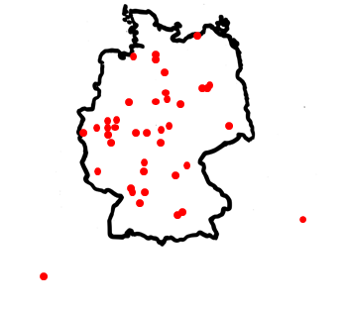
RDMO: widespread in Germany
Running at our university and many other research institutions
You can export and re-import your DMP as XML, e.g. at your new work.
Wien
Lyon

Slide 53
Tool-selection
Graphics or tables needed?
Word processing program, at least in a final step
yes
no
Composition of an own repository?
Word processing program
yes
no
Big project or CRC?
RDMO
yes
no
Unique questionnaire
Comparability
RDMO or word processing program

Slide 54
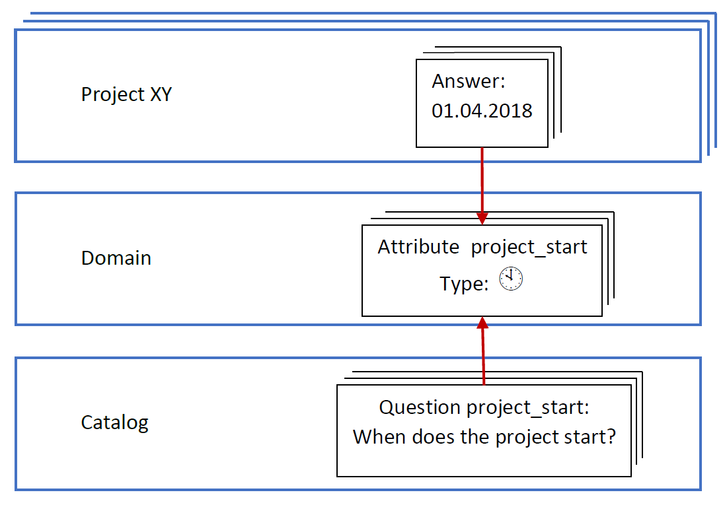
RDMO: question answer assignment
Questions and answers are linked via "attributes". Therefore, switching the question catalog is possible.
01.09.2024

Slide 55
Technical quality assessment

Slide 56
Quality control for numerical data
Type | Check
Numerical | Really a number?
 | Overflow?
 | NaN (Not a Number)?
Integer | Really integer?
Missing value | Use everywhere the same identification marking, e.g. MV
Every type | Is the value allowed? Compare with codebook, e.g. is the value really 1, 2 or 3 for model sub-type

Slide 57
Check for completeness
All files there, including model input?
In case you use parallel computing, do processes/threads work in the right sequence? Frequent error: empty blocks in the output if your I/O process does‘nt wait
Main
A
B
I/O
time

Slide 58
Research data repository
PublicData.fdm.uni-wuppertal.de

Slide 59
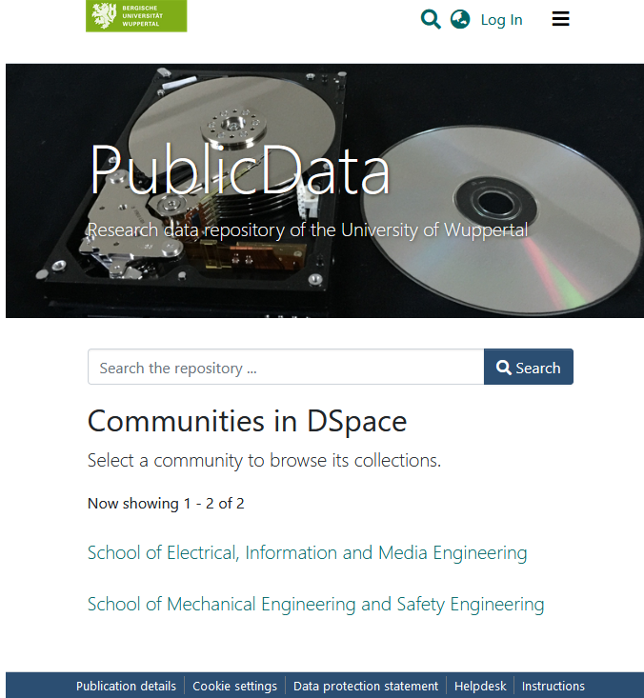
PublicData: institutional research data repository of our university
Publicly accessible under publicdata.fdm.uni-wuppertal.de
Storage by data creator
DataCite DOI can be assigned.
Versioning
End user agreement (German) public under: fdm.uni-wuppertal.de/de/langzeitspeichern/repo/speicherungsvereinbarung

Slide 60
PublicData: structure
Repository
Community
Community
Community
Community
Community
Community
SubCommunity
SubCommunity
Collection
Collection
Item
Item
Files
Metadata
Files
Metadata

Slide 61
PublicData: prepare for storage
Login with ZIM account
Create
structure
Prepare
collection
Grant
permission
Submit
DSpace admin
Submitter

Slide 62
PublicData: submit workflow
Accept
end user
agreement
Enter
metadata
Upload
files
Enter file
descriptions
Set
embargo
Select CC
license
under „Upload files“
Maximum size of a single file : 10 GB
Maximum size of the whole Item: 512 GB
Compressed files allowed, e.g. *.zip, *.tgz

Slide 63
PublicData: involved services
Metadata
Researcher uploads data files
and enters metadata
Data
Metadata
Repository software DSpace (Java, Open Source)
Apache2 web server
DSpace
Data base
Data
ZIM‘s
backup
service
ZIM‘s backup service
Fileserver
Backup

Slide 64
Metadata (metadata scheme: Dublin Core). Please enter them in English:
Compulsory metadata (metadata scheme: Dublin Core). Please enter in English:
Authors | People who have made significant contributions to this item: name, first name, ORCID iD
Title | Title: should clearly distinguish the item while still being short
Date of Issue | For secondary storage, fill in the date of the initial storage; otherwise, the current date is used.
Type | For research data usually "Dataset"
Language | The most widely used language in the data (not the metadata). If the Item doesn‘t contain text, e.g. for pure numerical oder image data, please use “N/A“.
Subject Keywords | Can be freely assigned
Abstract | Description of the item
+ further optional metadata

Slide 65
Data formats for long-term archiving
Data type | Data format
Text | PDF/A; Markdown, LaTEX, (docx, odt)
Spreadsheet | CSV (Comma-Separated Value)
Raster graphics (photo, screenshot) | TIFF, TIFF-LZW, JPEG2000
Vector graphics | XML/SVG

Slide 66
Text: PDF (Portable Document Format)
Page description language with a focus on document output true to original
Two important specific formats
PDF/A (PDF for Archive) | for long-term archiving
PDF/X (Xchange) | for pre-press (Druckvorstufe)
PDF/A:
All fonts and images used in the document are embedded.
Animations, videos, and other elements that need external software are not embedded.
Colors as close as possible to the colors in the document
No encryption

Slide 67
Spreadsheet
Microsoft Excel
Comma Separated Value (CSV)
 | A | B | C
1 | x | y
2 | 1 | 3
3 | 1.5 | 3.5
4 | 1 | 4
x
y
Importance
;
; Importance
1
3
;
;
Export to CSV
1.5
3.5
;
;
1
4
important
;
; important

Slide 68
PublicData: Quality control compulsory before DOI creation
Quality
control
report
Submit Workflow
Quality
control
DOI creation
Your quality control report
English
Lists control steps, e.g. “Plausibility and completeness of the data checked through visualization with…”
At least readability tests: “All files in xyz format can be read with software XYZ.”
Send it to rathmann@uni-wuppertal.de

Slide 69

Thanks for your attention!
Photo: Sebastian Jarych

